Slide 1
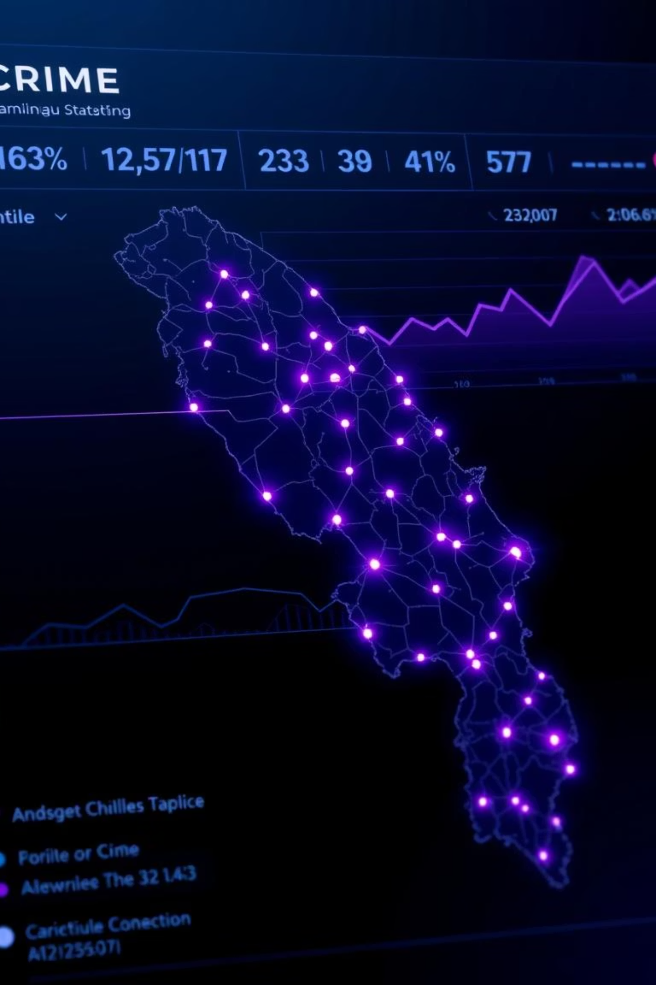

Tamil Nadu Crime Data Analysis (2014–2021)
Hiring Task – Data Analyst Role at Albaatros
Presented by: D Praveen Kumar
by D PRAVEEN KUMAR

Slide 2
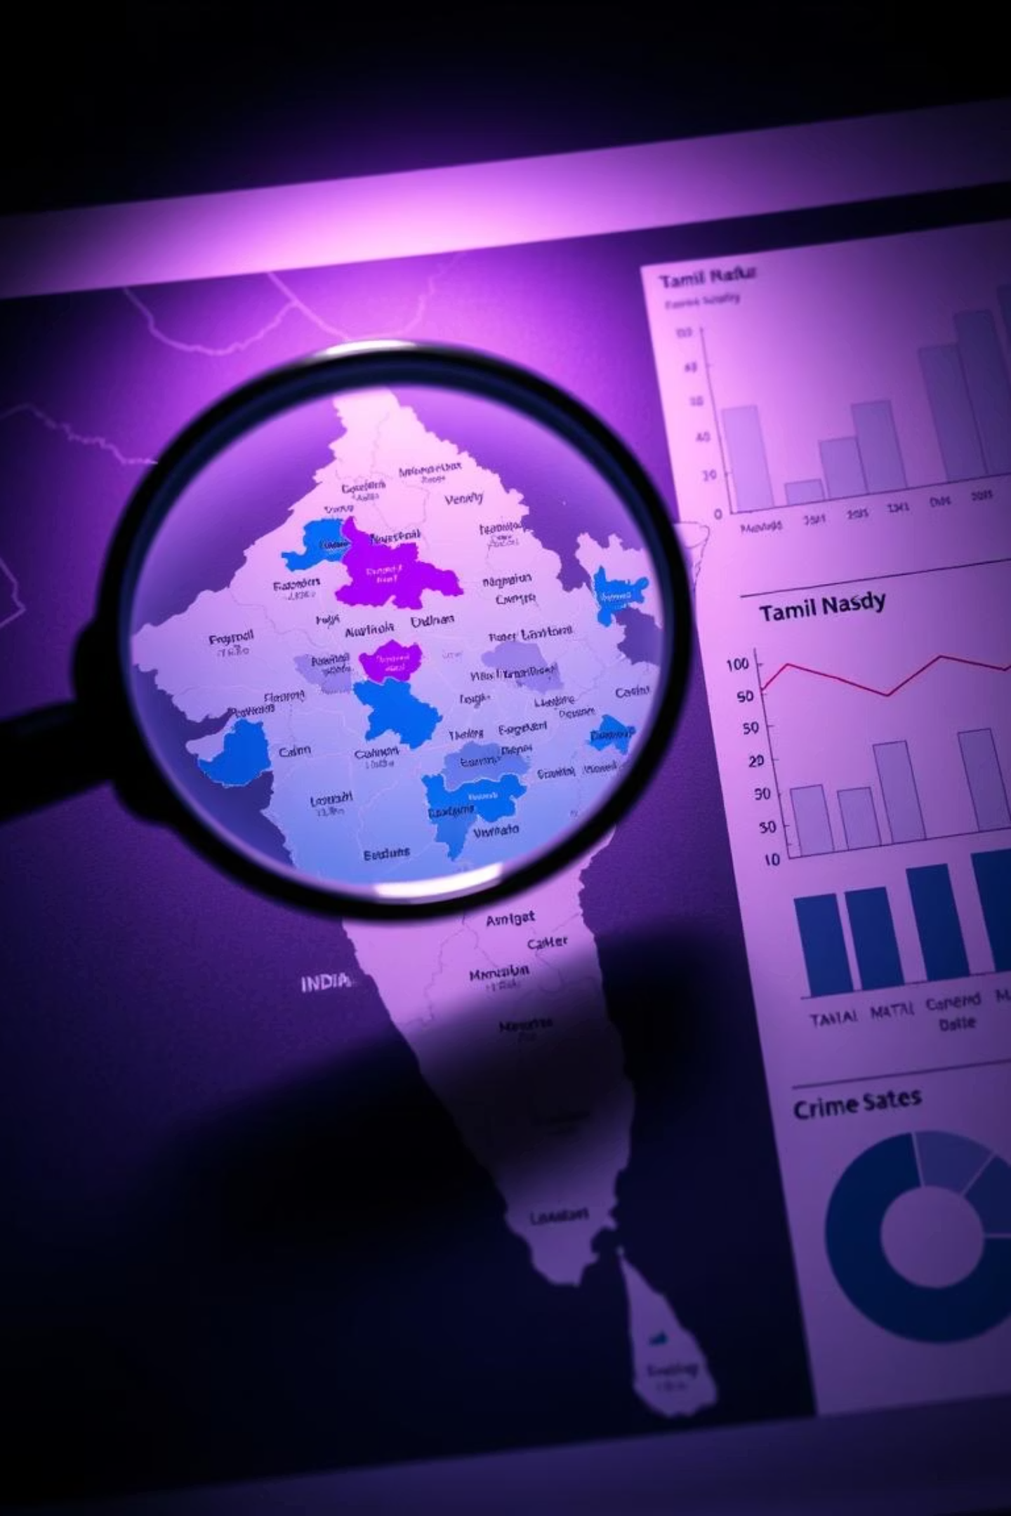
Project Objective: Uncovering Crime Dynamics
Our mission was to analyse crime data in Tamil Nadu from 2014-2021. We aimed to identify trends, patterns, and anomalies, pinpoint high-crime districts, and discover correlations. Ultimately, our goal was to recommend actionable strategies for crime prevention and resource allocation.

Slide 3
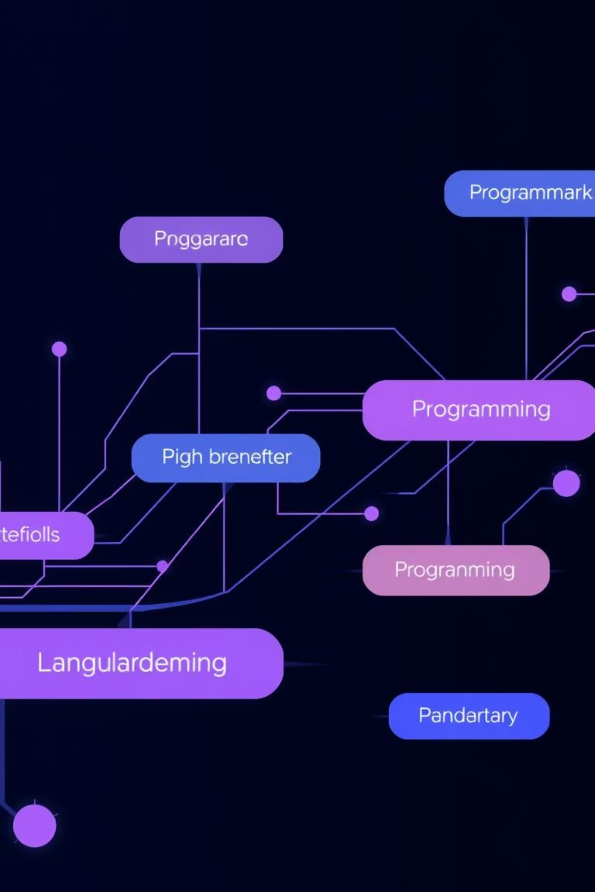



Our Toolkit: Powering Data Insights
Python & Libraries
Jupyter Notebook
We harnessed Python, along with powerful libraries like Pandas for data manipulation, and Matplotlib/Seaborn for compelling visualisations. These tools formed the backbone of our analysis.
Jupyter Notebook provided an interactive environment for our entire workflow. It allowed for seamless data cleaning, aggregation, and iterative visualisation, ensuring transparency and reproducibility.
Data Transformation
Our process involved meticulous data cleaning to handle missing values and normalisation, ensuring data integrity. Aggregation techniques were applied to summarise complex datasets for trend analysis.

Slide 4
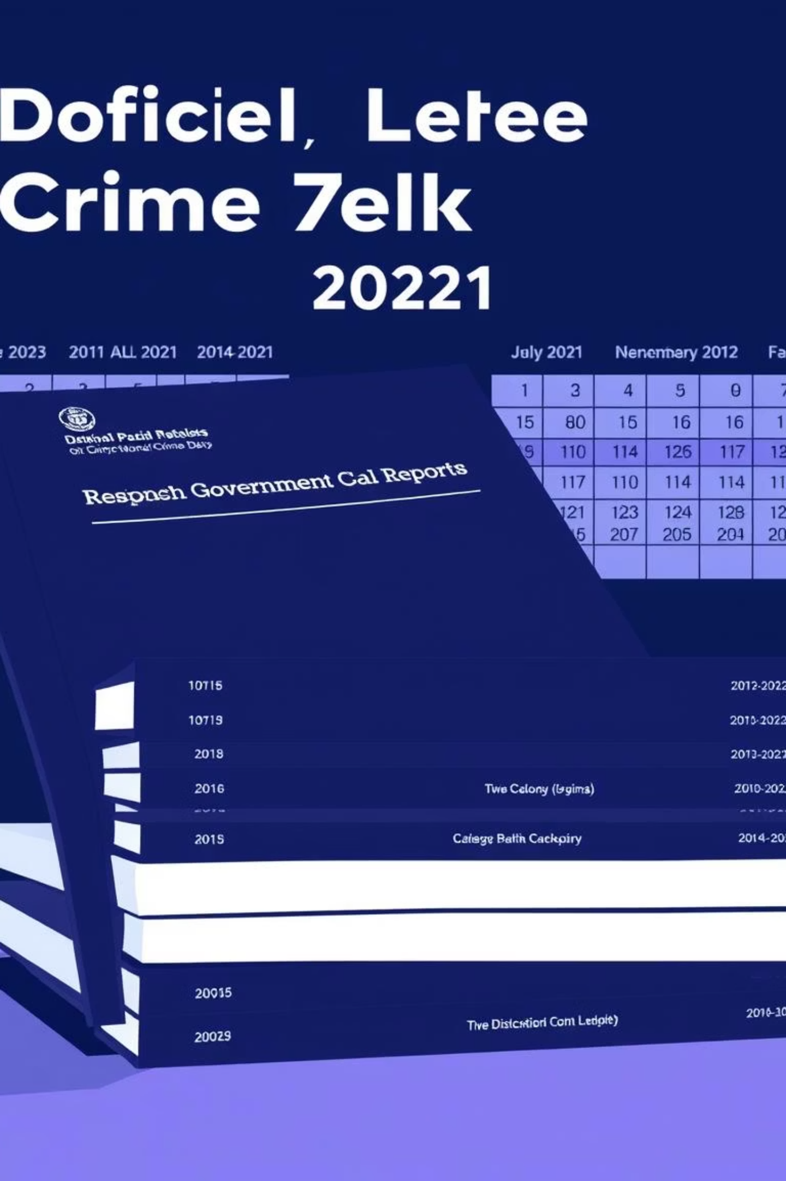
Dataset Overview: The Foundation of Our Study
Our analysis relied on comprehensive district-level crime data spanning 2014 to 2021. This rich dataset was sourced from reputable institutions like the National Crime Records Bureau (NCRB) and the Tamil Nadu State Police. It covered over 48 districts across 8 years, providing a robust foundation for identifying nuanced crime patterns and trends. Rigorous preprocessing, including NaN handling and normalisation, ensured data quality and consistency.

Slide 5
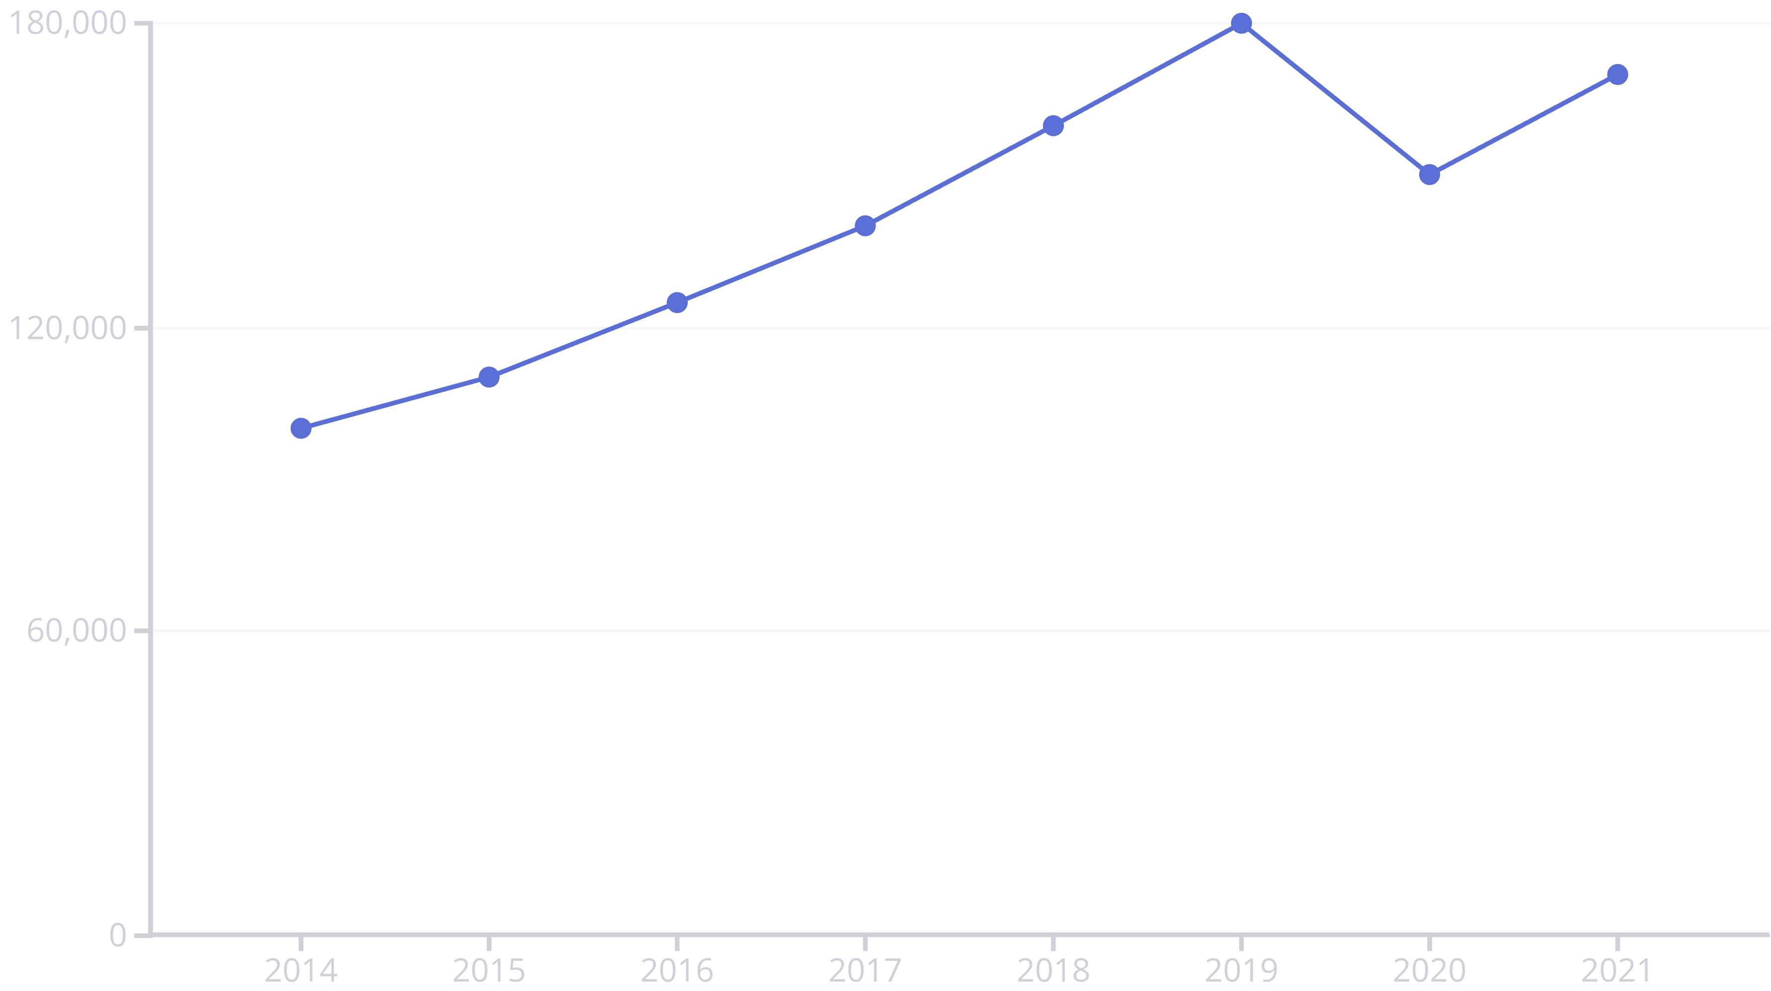
Statewide Crime Trends: A Closer Look
Our analysis of total reported crimes per year reveals a significant peak in 2019, followed by a noticeable dip in 2020, likely attributable to the global COVID-19 pandemic. A compelling upward trend in crime incidence is evident post-2016, highlighting the need for proactive interventions.

Slide 6





Top 5 Crime Districts: Urban Hotspots
Unsurprisingly, major urban centres such as Chennai, Madurai, and Coimbatore consistently lead in crime reporting. These districts exhibit a higher density of incidents year-on-year, driven by factors like population concentration and economic activity. A year-wise line plot for these top 5 districts further emphasises their persistent challenge.
Chennai
Consistently the highest reporting district due to its large population and diverse economic activities.
Madurai
A significant urban hub with a steady increase in reported incidents.
Coimbatore
Another major industrial city contributing significantly to the overall crime statistics.
Tiruppur
Emerging as a new hotspot, showing a noticeable spike in crime rates in recent years.
Thanjavur
A rural district that has seen unexpected and sudden increases in crime post-2017.

Slide 7
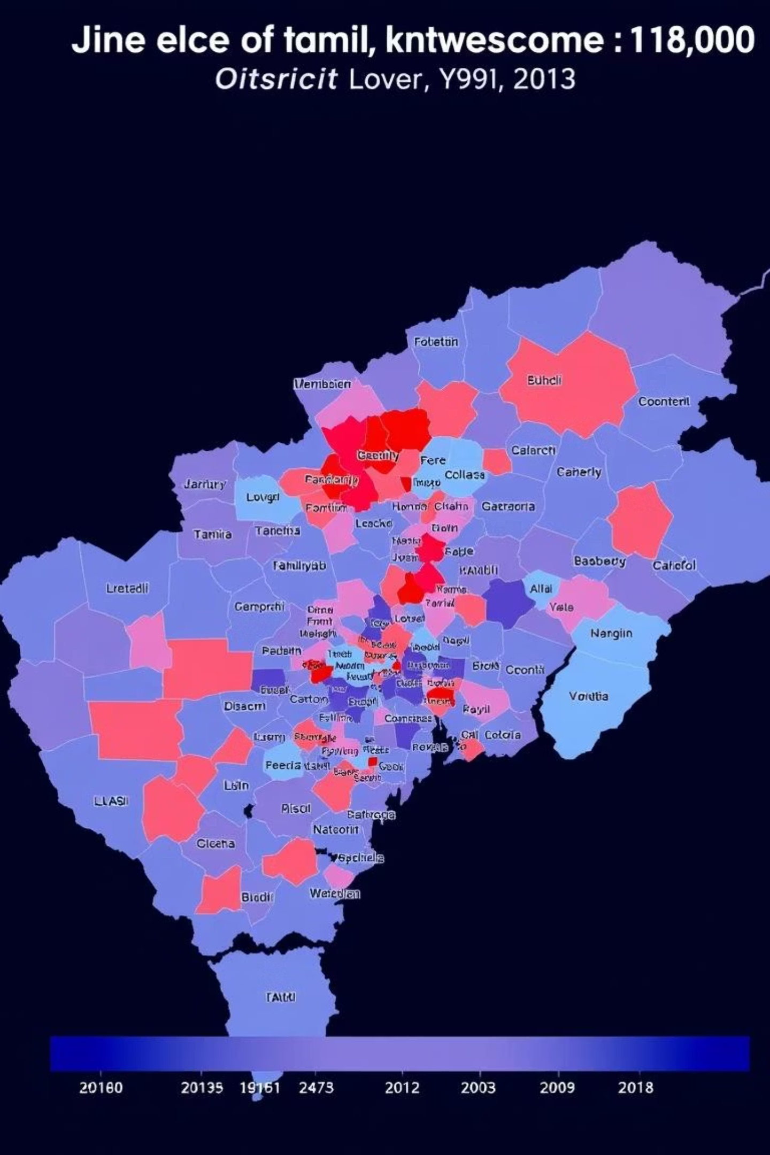
Crime Intensity: Unveiling Hot Zones
Our crime intensity heatmap, mapping districts against years, vividly highlights areas of crime concentration. It identifies emerging hot zones, such as Tiruppur and Thanjavur, which have seen unexpected spikes in crime rates post-2017. This visual representation is crucial for understanding the geographical spread and evolution of crime. These insights help direct resources effectively, enabling targeted interventions and strategic policing efforts.

Slide 8
Key Insights & Recommendations
Key Insights
Recommendations
Steady increase in crime till 2019, with a dip in 2020 due to COVID.
Focus policing and resource allocation on the top 5 districts for maximum impact.
Chennai remains the highest reporting district, highlighting urban challenges.
Allocate resources based on crime correlation with the state trend for efficient deployment.
Several rural districts, including Tiruppur and Thanjavur, experienced sudden spikes post-2017.
Invest in early detection and prevention systems, especially in emerging hot zones.
Urban crime patterns significantly influence the overall state crime curve.
Consider extending analysis to predictive modelling and dynamic dashboards for proactive crime management.

